Slide 1
Topic: ARDUINO AND IR SENSOR
1ST ONLINE NATIONAL HACKATHON ON TECHNOLOGICAL INNOVATION FOR TOYS
Organized by Start-up Cell:Prakaousol
National Institute of Technology,Arunachal Pradesh
Sposored by TEQUIP-III
Tech Toy 2020
Created and Presentation by
Tejas M.N
2ND Year student ,B.E Computer Science
Dr.Ambedkar Institute of Technology,Bangalore

Slide 2
How to control two LED’s using TV remote or any other IR remote using IR sensor.
Objective:
Understand the working principle of IR sensor.

Slide 3
ARDUINO UNO
The Arduino Uno is an open source microcontrollerboard based on the Microchip ATmega328P microcontroller and developed by Arduino company

Slide 4
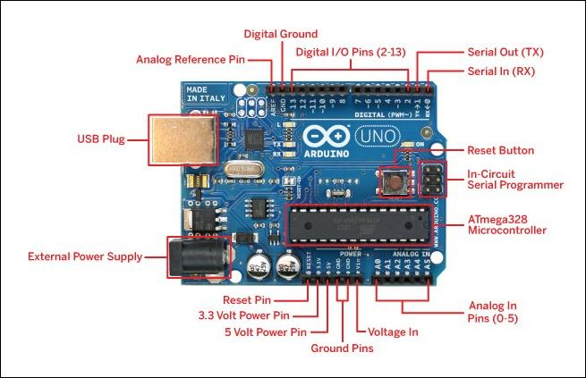
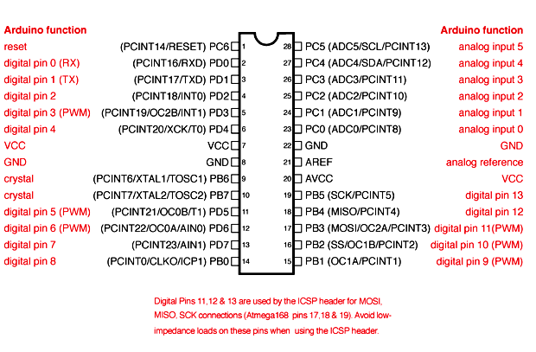
ATmega328p microcontroller
Arduino UNO Board

Slide 5
Technical specifications of ARDUINO UNO
Microcontroller | ATmega328P
Operating Voltage | 5V
Recommended Input Voltage | 7-12V
Analog Input Pins | 6 (A0 – A5)
Digital I/O Pins | 14 (Out of which 6 provide PWM output)
DC Current on I/O Pins | 40 mA
DC Current on 3.3V Pin | 50 mA
Flash Memory | 32 KB (0.5 KB is used for Bootloader)

Slide 6
Technical specifications of ARDUINO UNO
Frequency (Clock Speed) | 16 MHz
Inbuilt LED | Pin 13
Reset button | Resets the microcontroller.
USB Plug | USB-B type to connect to computer
Software required:
Arduino IDE (Integrated Development Environment) is required to program the Arduino Uno board. Link:https://www.arduino.cc/en/guide/windows

Slide 7
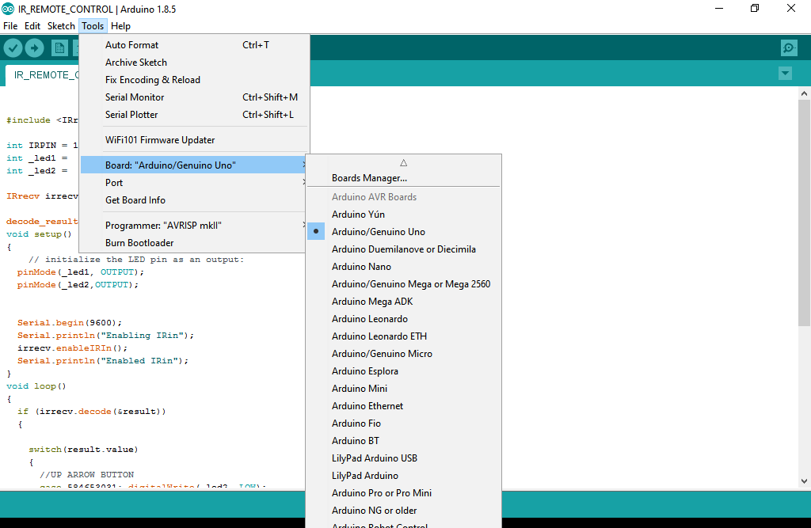
Programming ARDUINO UNO
Once arduino IDE is installed on the computer, connect the board with computer using USB cable. Now open the arduino IDE and choose the correct board by selecting Tools>Boards>Arduino/Genuino Uno, and choose the correct Port by selecting Tools>Port. Arduino Uno is programmed using Arduino programming language based on Wiring.

Slide 8
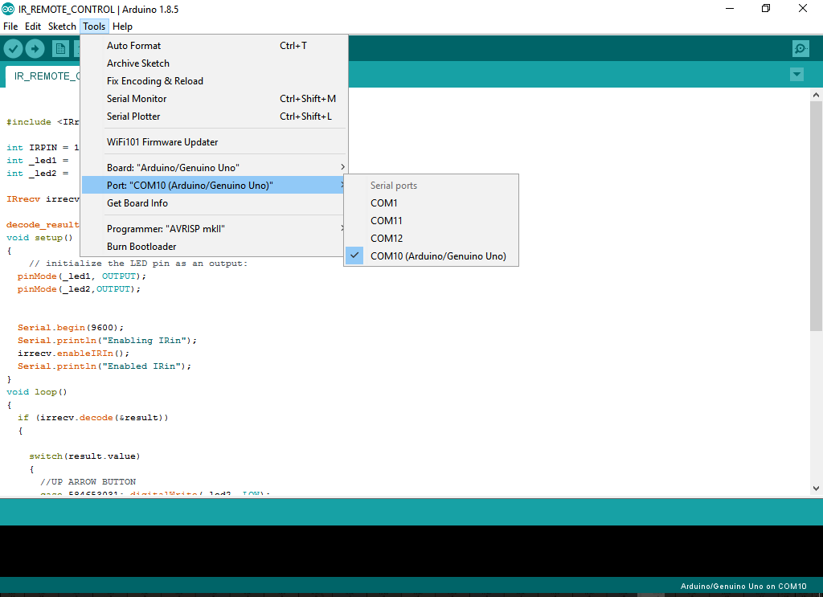

Slide 9
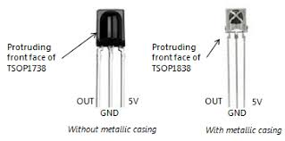
TSOP1738 IR reciever
TSOP1738 is an IR receiver with an amplifier that acts as a switch and converter within a circuit. It has one input and output which only acts on the base of the input IR signal. The basic purpose of TSOP1738 is to convert the IR signal to electric signals. Every IR receiver has a special frequency to operate. TSOP1738 operates on 38KHz IR frequency. In case of higher or lower frequency, it may act due to a current leakage or some other errors but it won’t fully operate. It uses silicon-based technology, which works at the microlevel and very sensitive and efficient to its functions. In summary, TSOP may be smaller in size but its usage with microcontroller and microprocessors makes it smart and secure. TSOP1838 is an improved version of TSOP1738 .

Slide 10
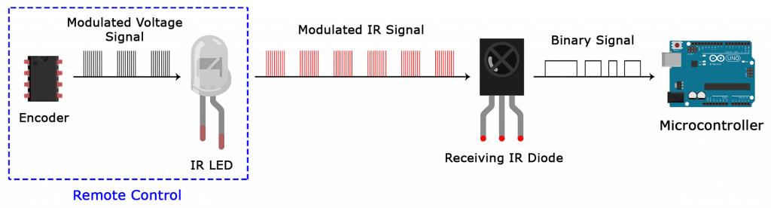
Working principle of the TSOP1738:
When the IR remote is pressed it sends out IR radiation. The TSOP1738 detects the IR which is switching on and off at the rate of 38Khz. TSOP’s output is active low, means its output will continue to remain HIGH when there is no IR, and becomes low when it detects IR radiation. So as to eliminate interference, the TSOP1738 operates at a particular frequency so that other IRs in the environment can’t interfere, except the modulated IR of particular frequency.

Slide 11
Components required:
Arduino uno
Breadboard
TSOP1838
IR remote
2 LEDs
Jumpers wires

Slide 12
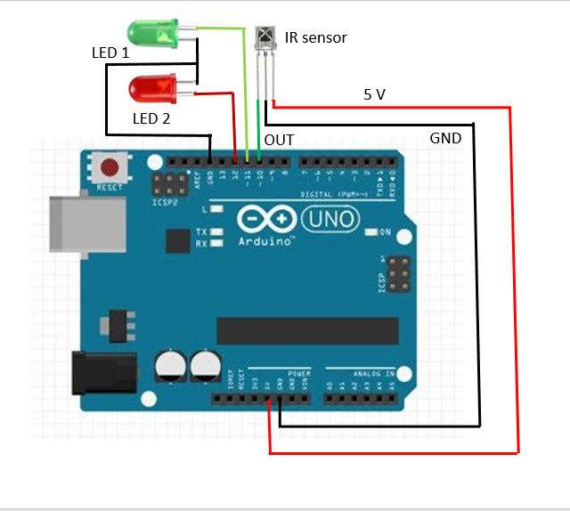
Circuit Diagram:
Connect the above mentioned components as shown

Slide 13
Decoding IR Remote Control Signals using Arduino
When any button of the IR Remote is pressed, the remote sends a code in form of train of encoded pulses using 38Khz modulating frequency. These pulses are received by TSOP1838 sensor and read by Arduino and then Arduino decodes received train of pulse into a hex/bin value and in turn will display it on the serial monitor.

Slide 14
Requirements:
Download the IR remote library from here : https://github.com/z3t0/Arduino-Irremote
Unzip it, and place it in your Arduino ‘Libraries’ folder.

Slide 15
Demonstration:

Slide 16
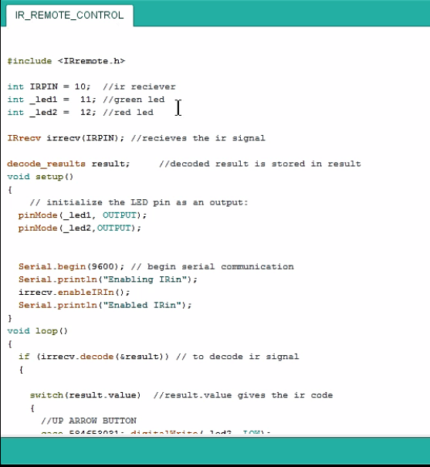
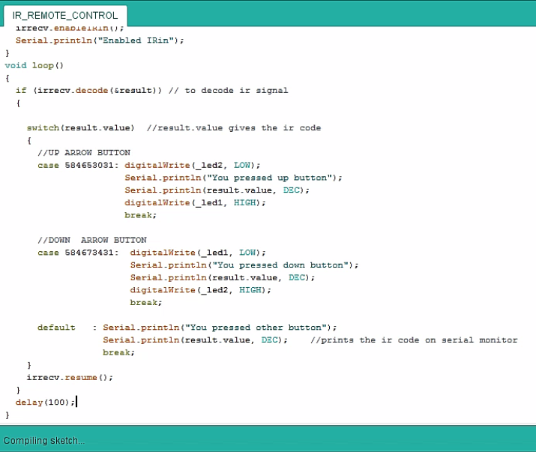
Program:

Slide 17
Flowchart:
START
Pin declarations
Receive the ir signal
setup
Initialize output pins and begin serial communication and IR input
A

Slide 18
A
Infinite loop
If IR signal is detected?
delay(100)
FALSE
TRUE
Is result.value
=584673431?
=584653031?
Turn off led 2
Turn off led 1
Print “you pressed up arrow button” and result.value
default
Print “you pressed down arrow button” and result.value
Print “you pressed other button” and result.value
Turn on led 1
Turn on led 2
resume

Slide 19
*****Thank you*****
Conclusion:
In this presentation we have
Understood the working principle of IR sensor.
How to control two LED’s using TV remote or any other IR remote using IR sensor.

